Slide 1

OPEN INFORMATION AND EDUCATIONAL ENVIRONMENT
FOR SUPPORTING FUNDAMENTAL
AND APPLIED MULTIDISCIPLINARY RESEARCH AT JINR
OPEN EDUCATION AT JINR
Panebrattsev Yu.A.
Online meeting for JINR information centers
December 2020, Dubna

Slide 2
Development of an open educational environment to support research priorities
in materials sciences and structure of matter
01
Online courses and new educational programs within the subject-matter of JINR projects on the basis of modern educational platforms
04
Educational web resource “Virtual Laboratory of Nuclear Physics”
02
05
Multimedia educational resources for websites of JINR laboratories
Educational materials for teachers and school students
03
Informational and educational support of NICA megaproject
06
Multimedia exhibits related to JINR subject-matter

Slide 3
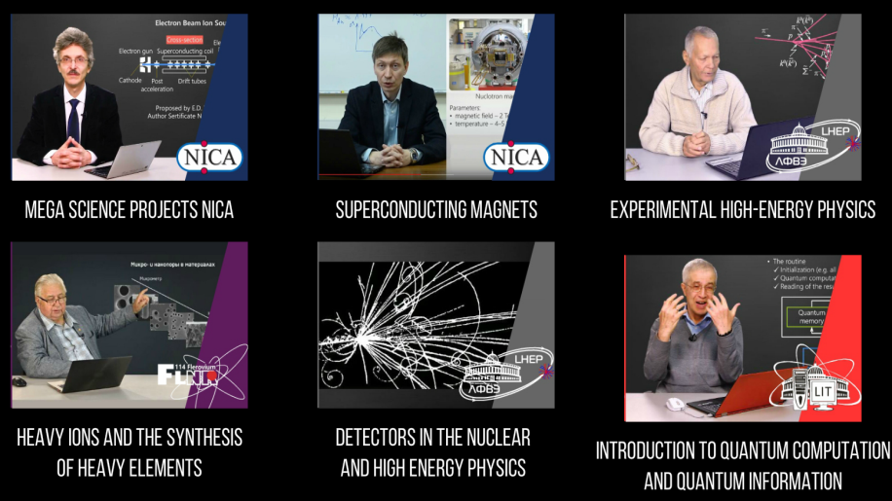
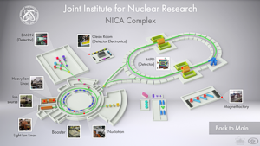
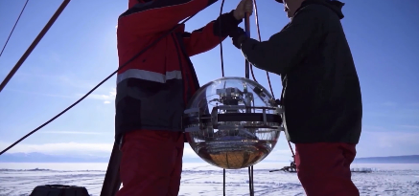
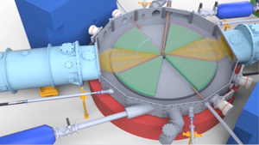
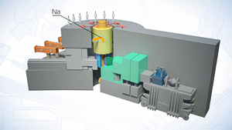
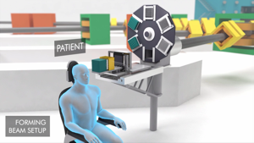
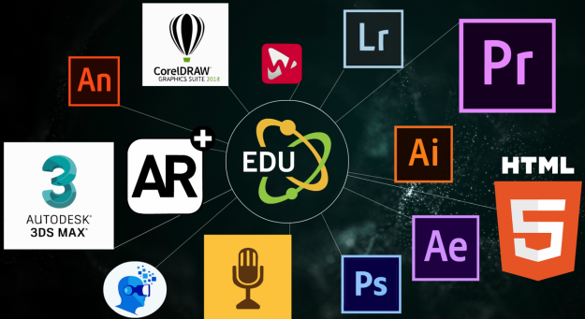
1. Online courses and new educational programs within the subject-matter of JINR projects on the basis of modern educational platforms
Online courses
JINR basic facilities

Slide 4
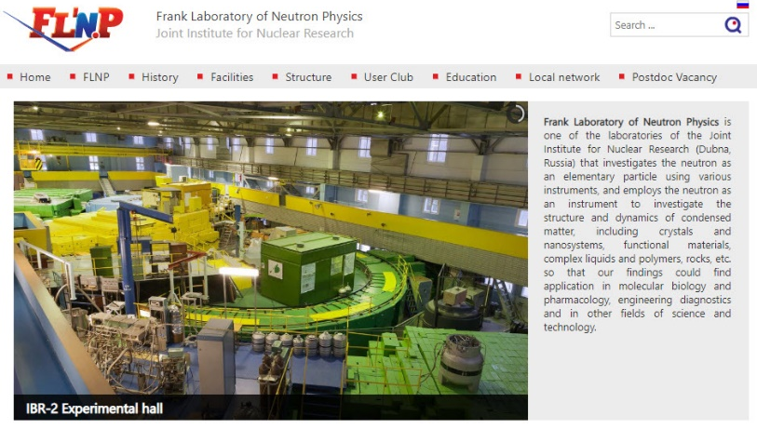
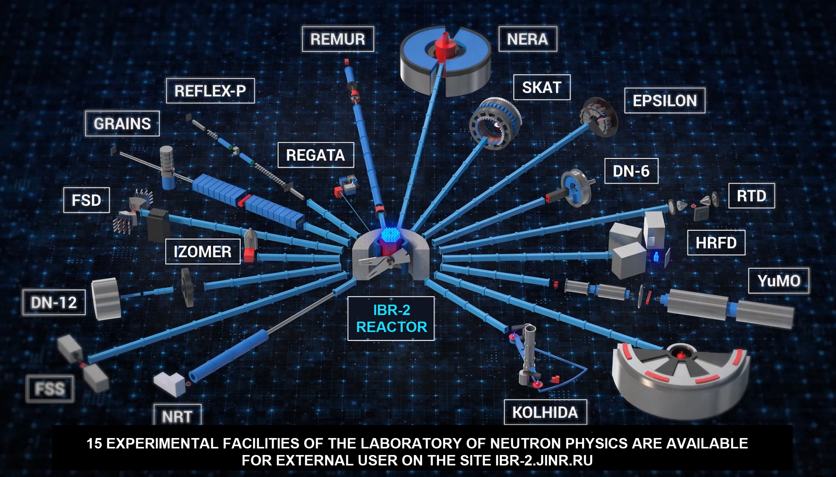
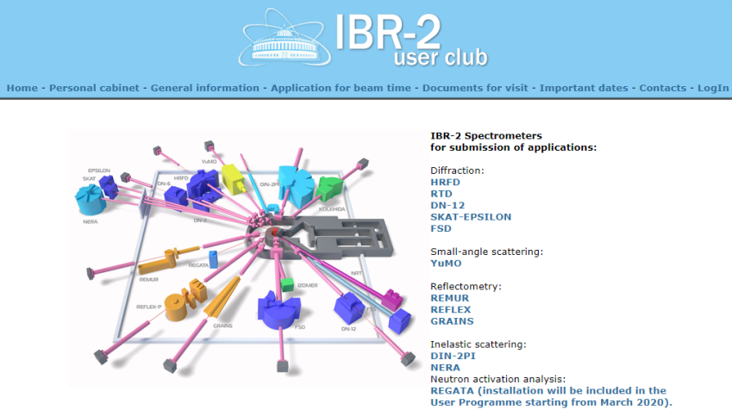
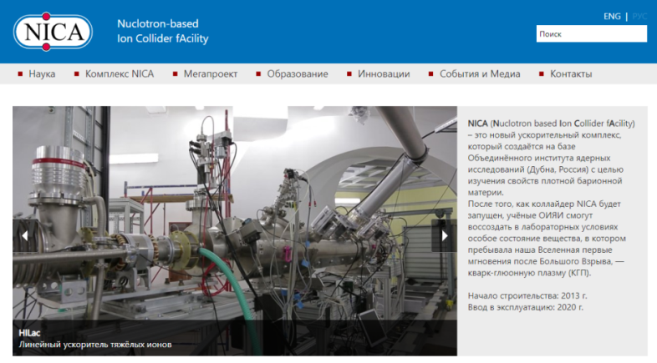
2. Multimedia educational resources for websites of JINR laboratories

Slide 5
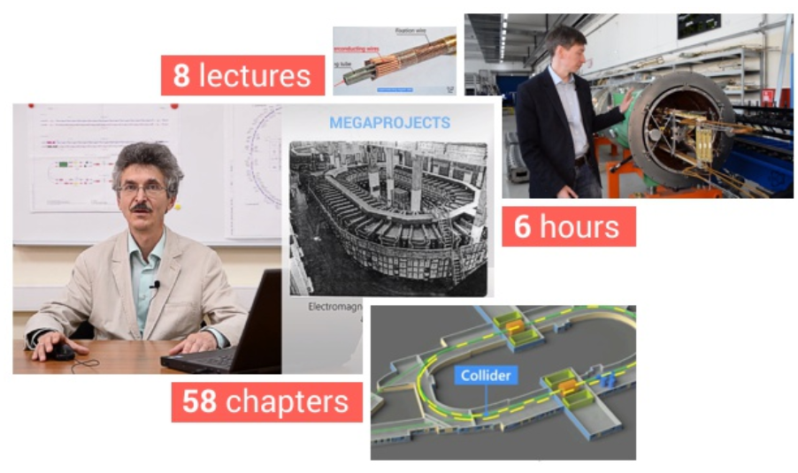
3. Informational and educational support of NICA megaproject

Slide 6
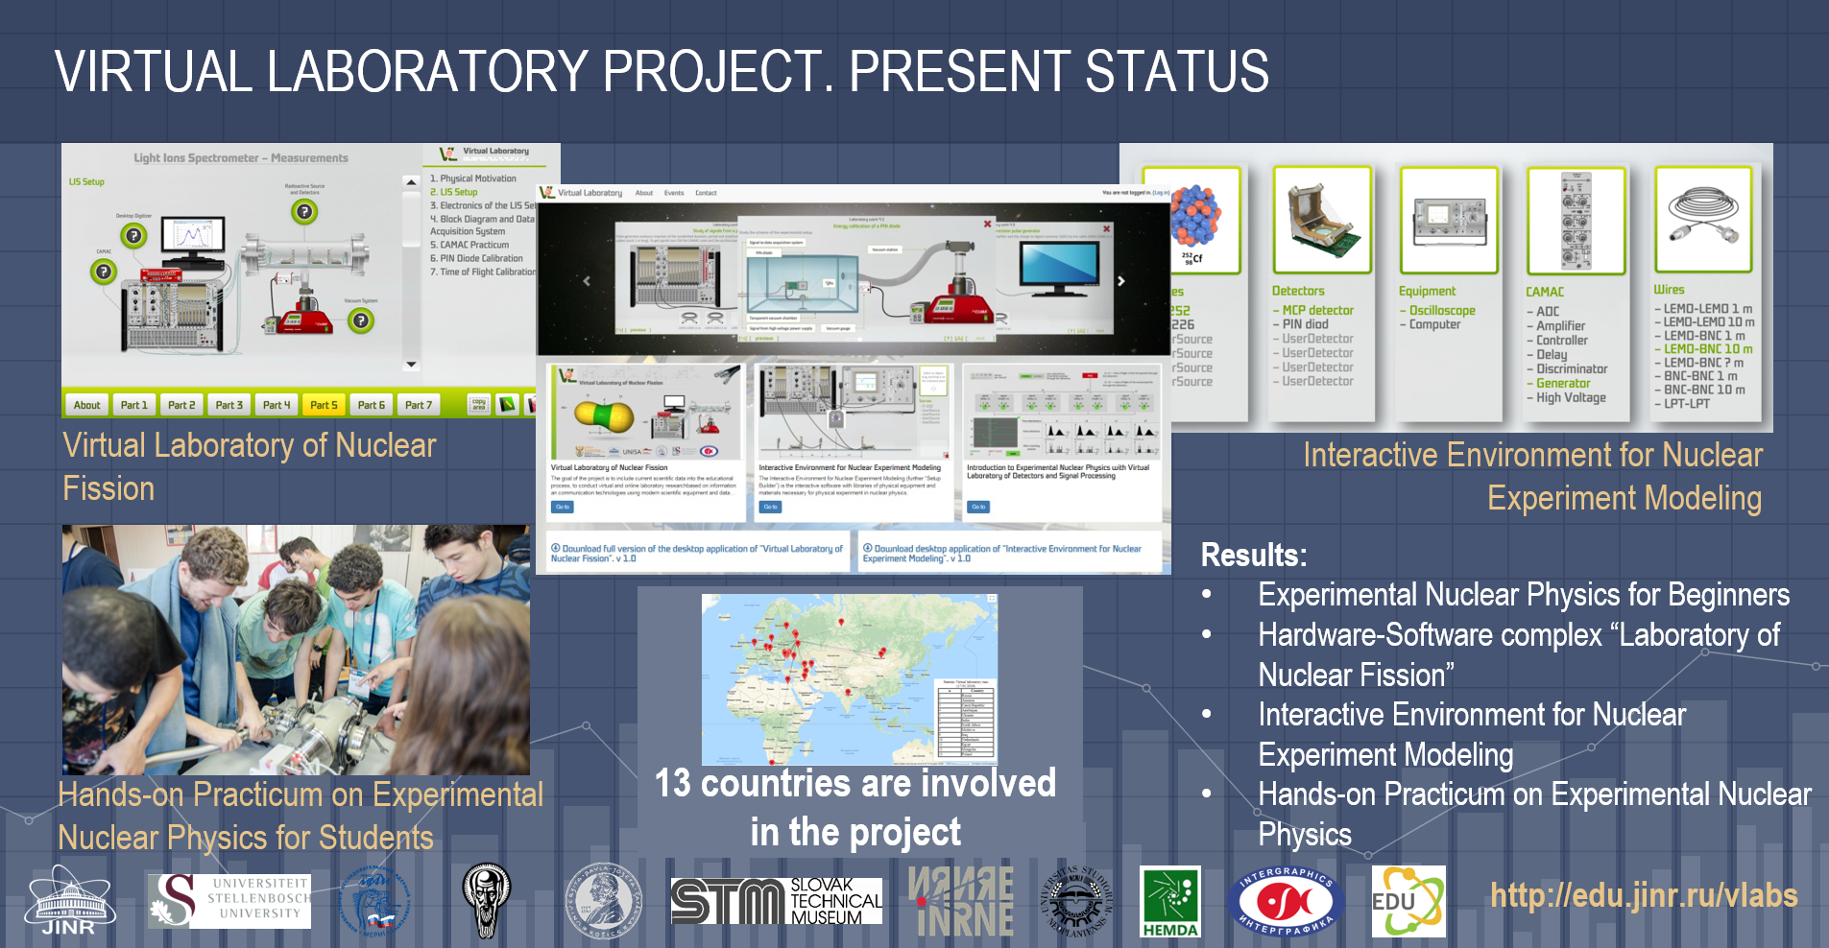
4. Educational web resource “Virtual Laboratory of Nuclear Physics”

Slide 7
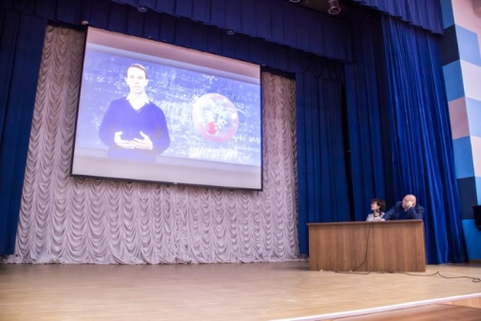
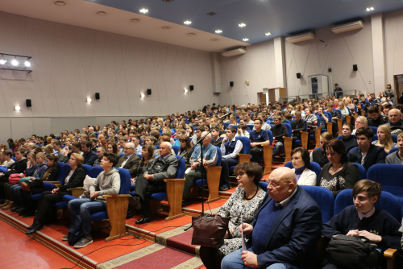
5. Educational materials for teachers and school students
Open video lesson “NICA – Universe in the Lab” for Russian schools
The site with educational materials “NICA – Universe in the Lab” was visited by representatives of more than 60 regions of Russia.

Slide 8
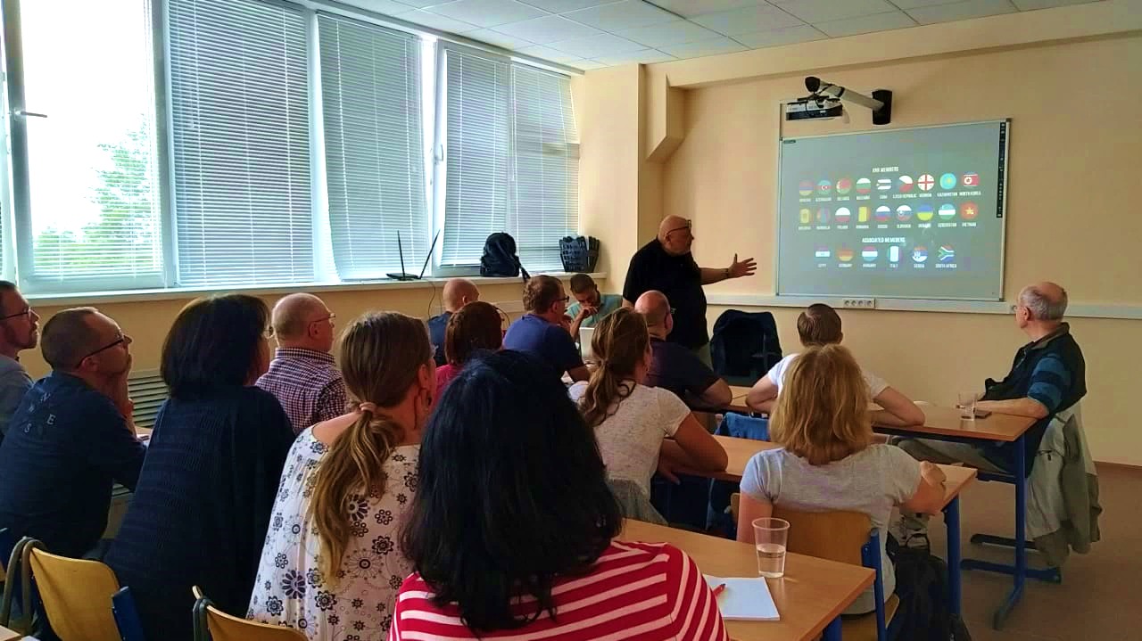
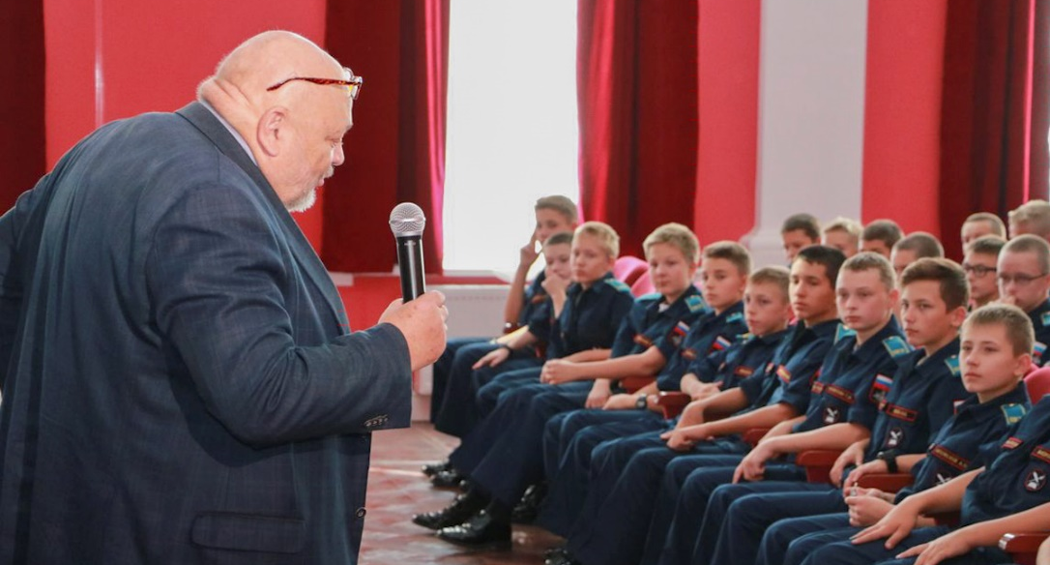
5. Educational materials for teachers and school students
New online courses for physics teachers illustrating the latest breakthroughs of science and technology;
New materials on nuclear physics for school students taking into account the concerns of the JINR Member States and Associated Members (with the possibility of translating educational materials into the languages of the participating countries);
Creation of a base of educational materials for use in science projects and research works within the physics course for schools;
Series of popular science lectures named Engineering – the Second History of Mankind;
Lectures and workshops for Schools of physics teachers at JINR and CERN.

Slide 9
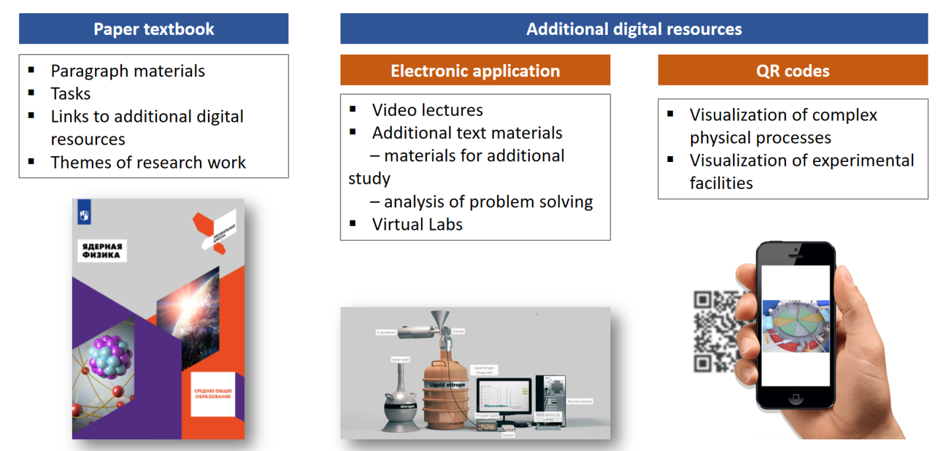
5. Educational materials for teachers and school students
The elective course “Nuclear Physics” for grades 10–11 of Russian schools

Slide 10
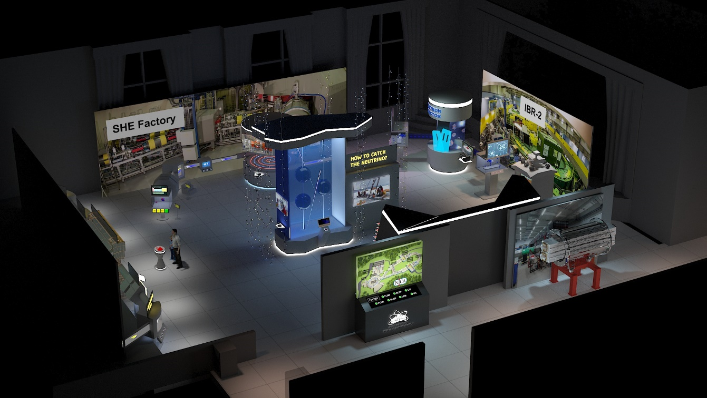
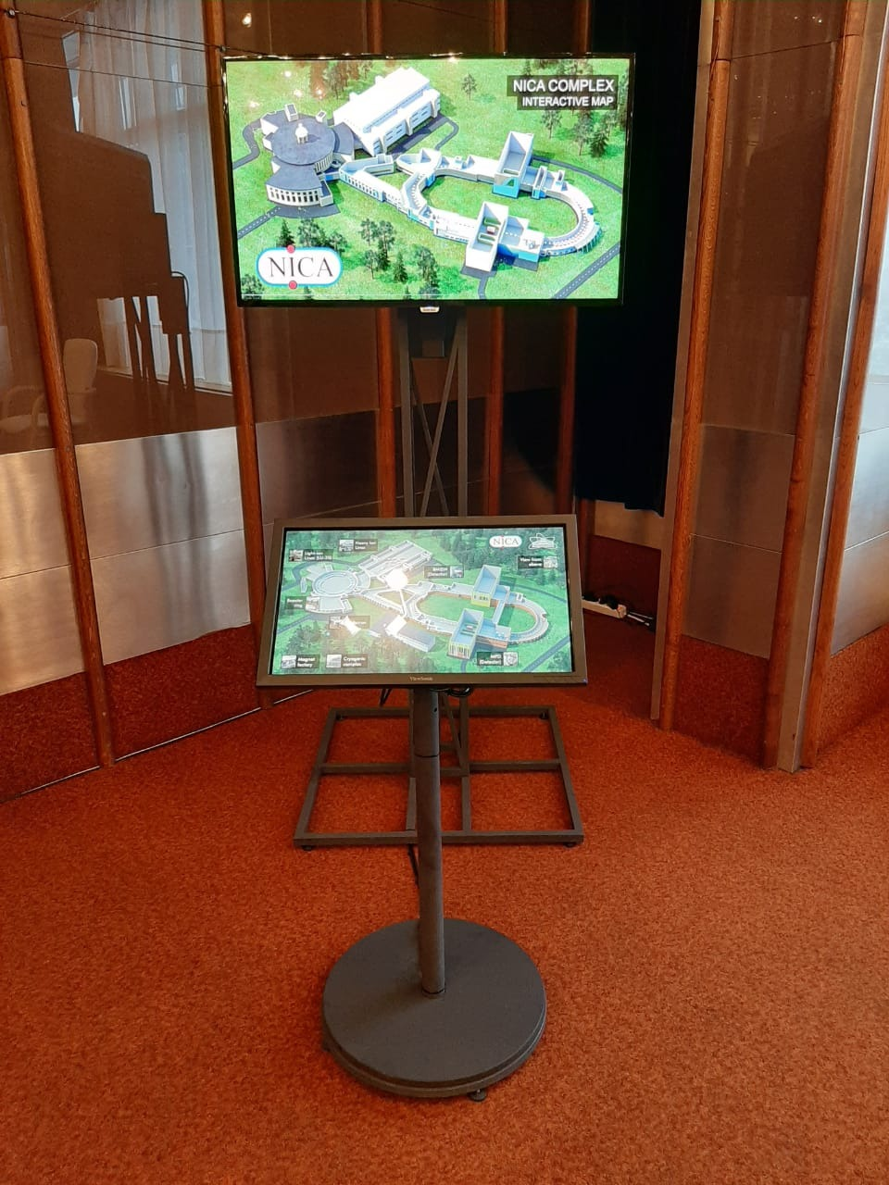
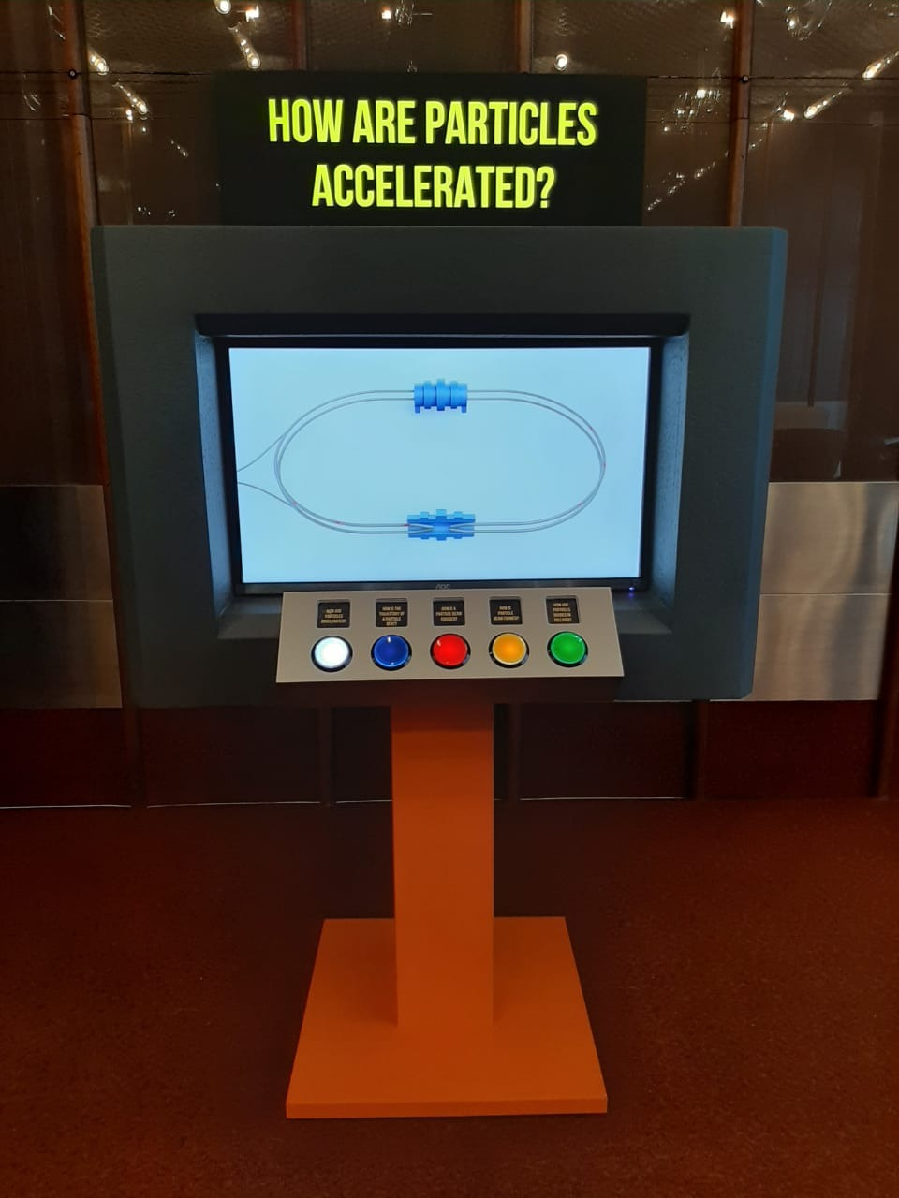
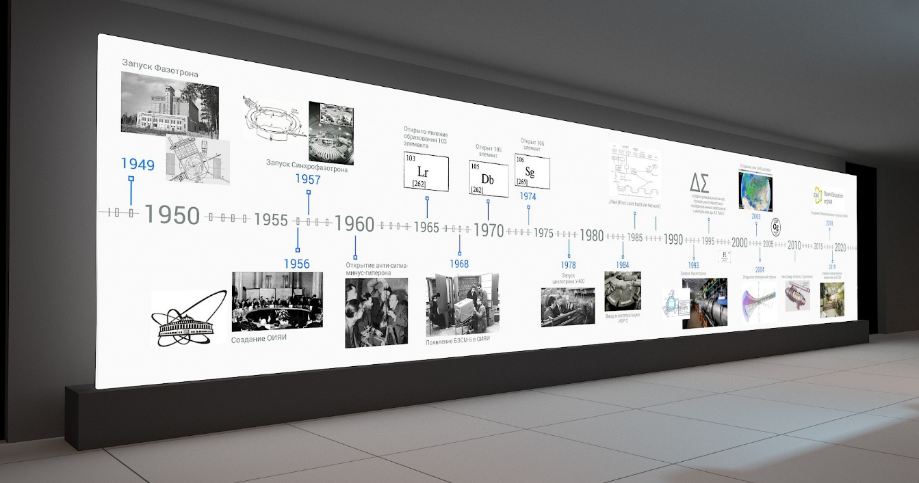
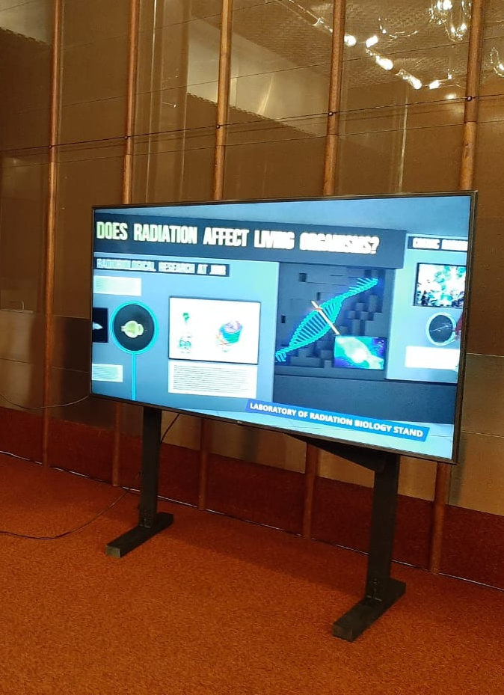
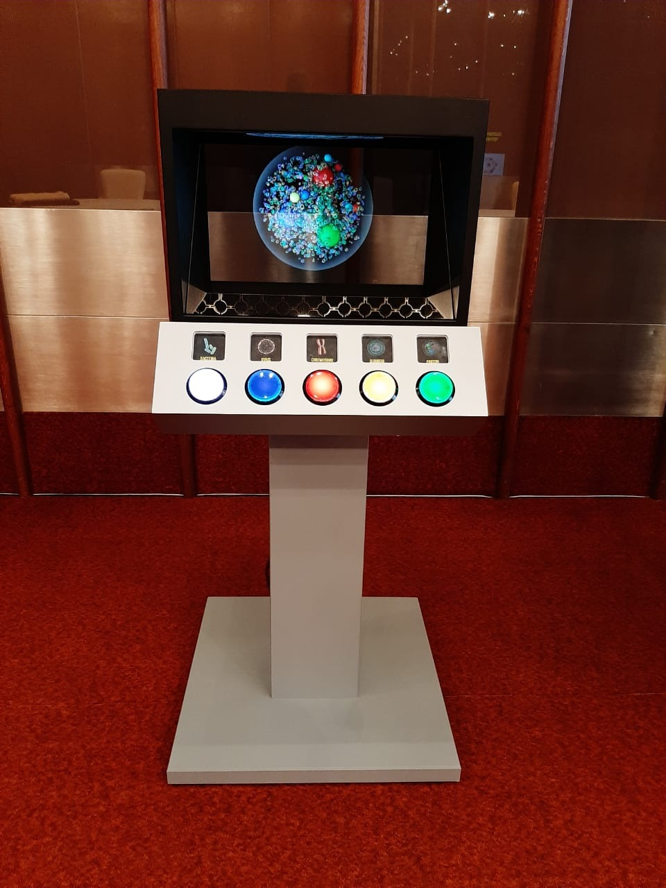
6. Multimedia exhibits related to JINR subject-matter

Slide 11
THANK YOU!

